Slide 1


Analysis
Alexandra Watson

Slide 2

ABOUT US
Lariat is a rental car company with several branches across the U.S. Along with branches conveniently inside U.S. Airports.

Slide 3

GOALS…
To make smarter business decisions by analyzing the costs and revenue generated by the rental car fleet.

Slide 4



The Data Process
Lariat Workbook
Combined
Cleaned
Analyized
We combined all the data into one easy workbook
We cleaned the data
We looked over the data and found ways to improve .

Slide 5
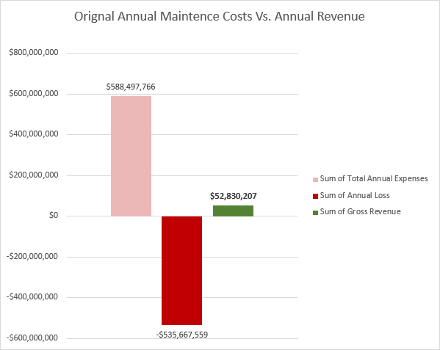
What we found….
After looking over the data. Two things stood out to me….
2. We loose over $536M a year from maintaining our vehicles. We should find a way to lower our maintenance expenses.

Slide 6
What we found….
The other thing I found was…
1. We bring in about $53M in Gross revenue from our rental service. We could raise the average daily rental price.

Slide 7
About the 2 Scenarios
Scenario 1: You can enter your own rental price to run tests on what you think is best! There are instructions on the sheet titled “Read Me.”
Scenario 2: displays everything you need to know in an easy-to-read breakdown.

Slide 8
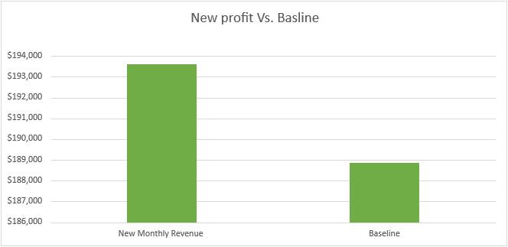
Scenario 1:
Change the values here! The charts will change as well.
User Scenarios:
 |  | Average Daily Rental $ | New Average Rental Price | New Monthly Revenue | Baseline
 |  | $144 | $160 | $193,600 | $188,856
 |  |  | You can change the values in column above!

Slide 9
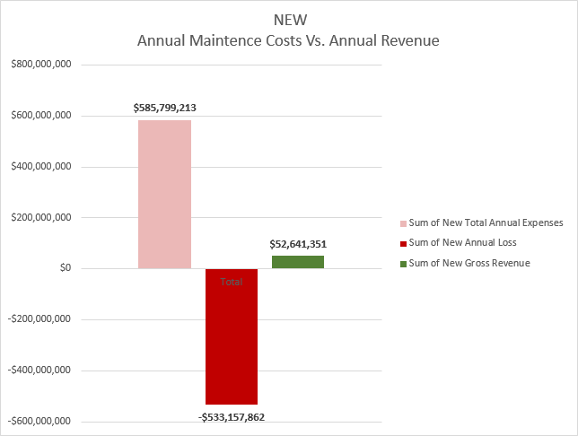
Scenario 2:

Slide 10

My Recommendations
Combine both strategies by increasing the average daily rental price and by eliminating at least the top 10 vehicles with the highest maintence expense. This will result in an increase in annual revenue by $2,127,456

Slide 11
Call To Action
Combine
Increase the Average Daily rental Rate
Eliminate the Top 10 most expensive vehicles to maintain.
This will result in an increase in annual revenue by $2,127,456

Slide 12
Thank you!
Alexandra Watson

